Slide 1
Vigenere Cipher
By Stephen Brewster, Win Herne, and Andy Bitry

Slide 2
The Challenge
Create an encryption program using the Vigenère cipher technique (similar to a Caesar cipher.)
In a Caesar cipher, each letter of the alphabet is shifted along some number of places; for example, in a Caesar cipher of shift 3, A would become D, B would become E and so on. The Vigenère cipher consists of several Caesar ciphers in sequence with different shift values.
Description Courtesy of Wikipedia.

Slide 3
Class Data Members
- int[] encoderArray
- int[] phraseArray
- char[] encodedPhrase
- char[] decodedPhrase

Slide 4
Class Methods
+ getEncoderArray
+ setPhraseArray
+ getEncodedPhrase
+ getDecodedPhrase

Slide 5
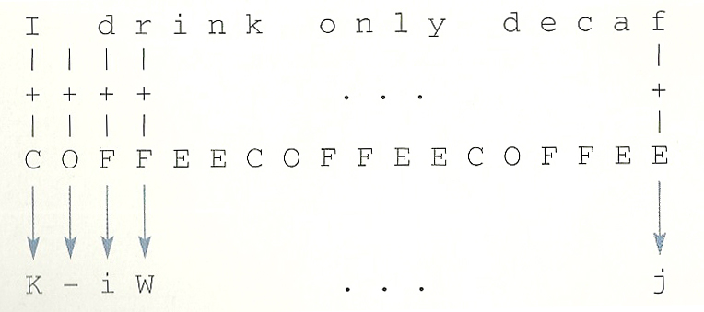
+ getEncoderArray
//This method turns the encoding key into an array
public void getEncoderArray(String s, int[] keyArray){
int length = s.length();
encoderArray = new int[length];
int j = 0;
for (int i = 0; i <= length - 1; i++){
encoderArray[i] = keyArray[j];
j++;
if (j > 5){
j = 0;
}
}
}

Slide 6
+ setPhraseArray
//This method puts the user's sentence into //an array as int
public void setPhraseArray(String s){
int length = s.length();
phraseArray = new int[length];
for (int i = 0; i <= length - 1; i++){
phraseArray[i] = (int)s.charAt(i);
}
}

Slide 7
+ getEncodedPhrase
//This method encripts the phrase
public char[] getEncodedPhrase(String s){
encodedPhrase = new char[s.length()];
for (int i = 0; i <= s.length() - 1; i++){
encodedPhrase[i] = (char)(phraseArray[i] + encoderArray[i]);
}
return encodedPhrase;
}

Slide 8
+ getDecodedPhrase
//This method will decript the phrase
public char[] getDecodedPhrase(String s){
decodedPhrase = new char[s.length()];
for (int i = 0; i <= s.length() - 1; i++){
decodedPhrase[i] = (char)((int)encodedPhrase[i] - encoderArray[i]);
}
return decodedPhrase;
}

Slide 9
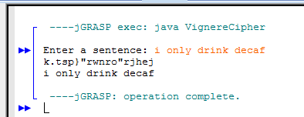
Main Program: VignereCipher
import java.util.*;
class VignereCipher{
public static void main(String[] args){
VignereEncoder v1 = new VignereEncoder();
Scanner keyIn = new Scanner(System.in); //Scans in the user's sentence to be encripted
String keyWord = "COFFEE", phrase;
System.out.print("Enter a sentence: ");
phrase = keyIn.nextLine();
char[] encodedPhrase, decodedPhrase;
int[] keyArray = {2,14,5,5,4,4};
v1.setPhraseArray(phrase);
v1.getEncoderArray(phrase,keyArray);
encodedPhrase = v1.getEncodedPhrase(phrase);
decodedPhrase = v1.getDecodedPhrase(phrase);
System.out.println(encodedPhrase);
System.out.println(decodedPhrase);
}
}

